Slide 1
An attempt at integrating: Envelopment
ISPS conference Stranger in the City
29 August 2019
Victor Kouratovsky

Slide 2
Intro
ISPS board NL & organizing committee Stranger in the City
Specialist Group Cultural Psychiatry Parnassia Mental Health
Special Committee on Cultural Diversity Dutch Institute for Psychologists (NIP)
International Committee on Cultural Consultation

Slide 3
Drive and background: clinical, ‘transcultural’ psychiatry, children, adolescents, and adults
What are the effects of migration and culture as seen from developmental psychopathology?

Slide 4
Why this vulnerabilty to psychosis?
Main answers of this conference
(intergenerational) trauma
Social and cultural exclusion
Societal and institutional neglect
Cultural barriers, ways of understanding
Psychiatric power /alienating structures
Lack of social cohesion--individual isolation – city life
Epigenetic vulnerability

Slide 5
This presentation
Special leads:
ASS, developmental language disorders and sensorimotor integration
Hypersensitivity, vulnerability, and psychosis proneness (‘ schizophrenia’ ) (The neurodevelopmental hypothesis of ..)
combined effects of stress on epigenesis, neurodevelopment, infant mental health, as well as on social identity formation and the effects of mixed cultural backgrounds, migration and trauma
Hypothesis:
=> Lack of envelopment
Envelopment: means of buffering stress, of integrating inside and outside

Slide 6
Outline presentation
Envelopment and stress
Basic processes:
Genetics and epigenetics
Neuronal development and workings
Developmental psychobiology
Group processes
Social cognition
Social exclusion
First impressions
Discussion

Slide 7
1. Stress and envelopment

Slide 8
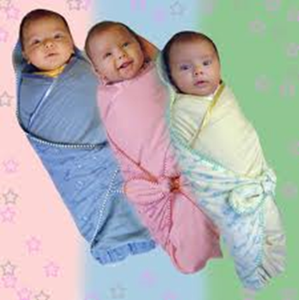
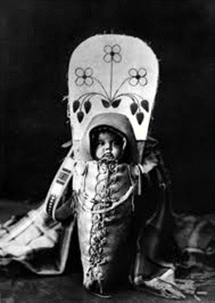
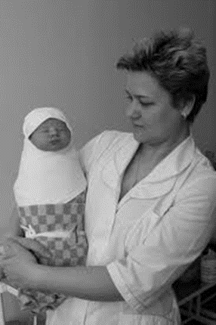
Envelopment

Slide 9
Being enveloped
Born in a niche
Sounds, smells, tastes, feelings, sights
Swaddling as culturally integrating
Name and gender
Pre birth, interactive life in the womb

Slide 10
Being formed
Swaddled, held, touched, oiled, massaged, seen
Fed, comforted
Pre birth, status and stress of the mother, name of the father
Place within the generations
Birth order
Living conditions: protection from the elements, enemies
patterns, techniques, resources, objects, structures, and environments transmitted by many previous generations
Experiences, meanings and expectations, stories, narratives

Slide 11
nature
culture
society
group
body
family
mind
Neuroscience macro feedback loops

Slide 12
Envelopmental layers and critical transitions
Life in the womb being born
Birth being accepted, taken care for
Toddler living up to expectations
Child picking up instructions
Adolescent gender role taking – prolonged schooling
Adult occupation
1. Caretakers-2. larger family-3. community-4. primary schooling-5. secondary and higher schooling, 6. society
MIGRATION/ radical change of environment

Slide 13
Stress: biophysical reaction to any change of pattern
a condition arising when external environment or internal sickness makes excessive or contradictory demands on an organism’s ability to adjust.
The organism lacks and needs flexibility, having used up all its available uncommitted alternatives (Bateson)
physical and mental effects of overwhelming stress
of being powerless and helpless

Slide 14
Stress involves all systemic levels/ living conditions:
body-brain-society-environment-geography
Interoceptive networks - gut (microbiome)-thinking-functioning
Constant en continuing interaction on all levels
Starting pre birth, intergenerationally
Building toxic effects over life: allostasis
leading to a variety of life-threatening and chronic physical and mental diseases and having a direct connection with psychosis and psychosis proneness

Slide 15
Stress
(Chrousos, 2009)

Slide 16
Culture buffering stress
An over the ages transmitted (but still ever changing) array of esp. behavioral patterns, often unconsciously active,
A tradition of purposeful training and learning, of formation
Preventing overwhelming stress

Slide 17
2. Basic processes
Genetics
Epigenetics
Developmental psychobiology --- developmental biopsychology
Biocultural co-constructionism
The expression of genes is dependent upon generations long and life long interaction with the [physical, social, cultural] environment

Slide 18
Neuronal growth
The building of patterns
Absolute necessary condition: sensorimotor input

Slide 19
brain emotion-affective processing
1. Primary-process, basic-primordial affects (sub-neocortical)
Emotional affects (emotion action systems; intentions-in-actions)
Homeostatic affects (hunger, thirst, etc.; via brain-body interoceptors)
Sensory affects (sensorially triggered pleasurable-displeasurable feelings)
2. Secondary-process emotions (learning via basal ganglia)
Classical conditioning
Instrumental and operant conditioning
Emotional habits
3. Tertiary affects and neocortical “awareness” functions
Cognitive executive functions: thoughts and planning
Emotional ruminations and regulations
“Free-will” or intention-to-act (Panksepp, 2010)

Slide 20
Executive functions PREFRONTAL CORTEX
Selfregulation
Being able to
stop, watch, listen & feel
1. REFLECTION
2. IMAGINATION
3. EMPATHY
4. CREATIVITY / PLAY
Self-talk
Self critisism
Self understandig
Looking forward and backward with the mind’s eye
Being able to think about own and other’s feelings/ mentalizing
Creating new thoughts and goals
Flexible, forwardlooking, optimal goal directive behavior

Slide 21
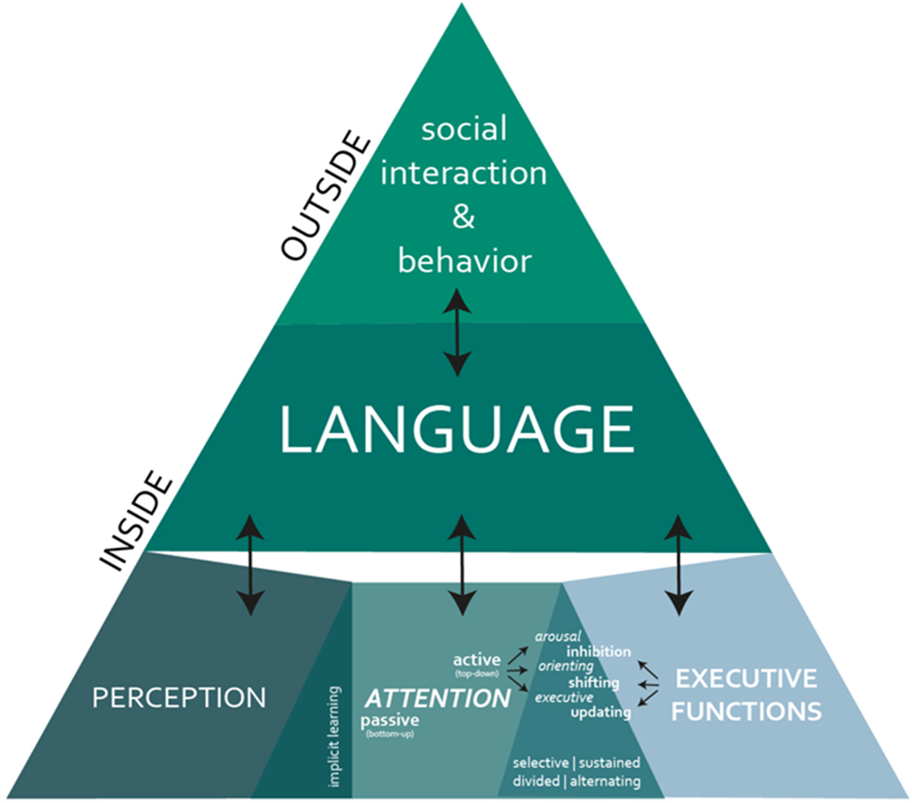
(Tomas & Vissers, 2019)

Slide 22
3. Group processes
Humans are essentially group beings
gifted with
the integrative power of language

Slide 23
Culture of the sperm whale
clans having distinct habits and manners ;
communicating by using ‘clicks’;
exclusive interaction with others clicking the same dialect;
young learn dialect by family, a process that takes many years .

Slide 24
First impressions
Within 1 second there is a ‘decision’ if another person is likable or not
Click or no click
With possible lasting effects disturbing social relationships
Dependent upon familiarity
Finding of / recognizing connection

Slide 25
Social cognition
automatic and implicit
learning by observation about places, objects, actions, agents
[secondary-process emotions (learning via basal ganglia)] (neural) mechanisms: association learning, gaze following, mirroring, reward learning
Benefits: survival by self-interest copying, prosocial effects of copying, alignment, group decisions, group identity, belonging
Resiliency

Slide 26
Social exclusion
Falling out of the (dominant) group
Strong (evolutionairy!) consequences: life and death
Normal, order Disordered
Discrimination Persecution Annihilation
Only the idea of being discriminated against, to be socially excluded…

Slide 27
Discussion
Lack of possibilities to integrate, of connecting available envelopmental structures to living conditions means
stimulus hypersensitivity and/or vulnerabilty to stress

Slide 28
Critical transitions
e.g.
Sensorimotor, physical layer problems with sensorimotor integration /epigenetic vulnerability to stress/language development
Caretaker layer lack of holding, containing, protecting
Community layer educational possibilities, exclusion, discrimination
Societal layer unemployment, poor housing, limited access to care
Environmental layer from rural to city life, from mountains to sea

Slide 29
Discussion
links to TED-like presentation https://vimeo.com/347264957/71eaf8fb63
Relevant recent literature
kouratovsky@gmail.com

